Slide 1

Programming 101
Programming for non-programmers.
You will need Python 2.7.10
Go to https://www.python.org/downloads/
Click , download it and install it.

Slide 2
Week 1
We learned to:
Read and write code
Building blocks of a program
Data types
Output
Input
Built-in functions

Slide 3
Week 2
We covered:
Two types of loop
Uses for each
Conditional statements
Branching paths
Libraries
Importing and using the ‘random’ library
Applications
Created a program that randomly generated maths problems

Slide 4
Week 3 – Objectives
This time:
The file editor
Comments
Functions
Classes
Encapsulation
Inheritance

Slide 5
Participation
Feedback is useful
Stop me if you get confused.
This is not a classroom
If you need to leave, that’s obviously OK.

Slide 6
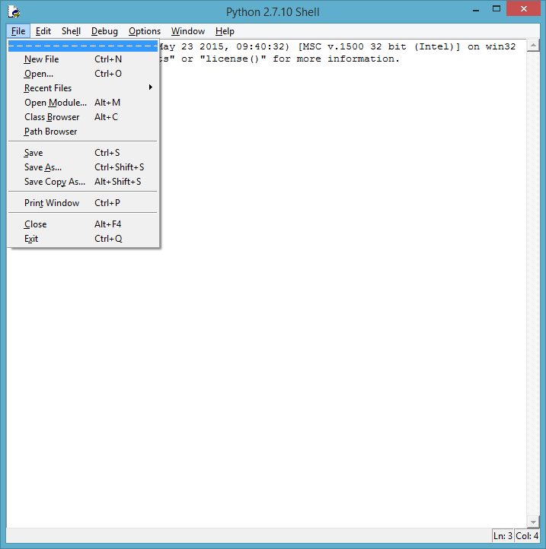
The File Editor
Open a new editor window

Slide 7
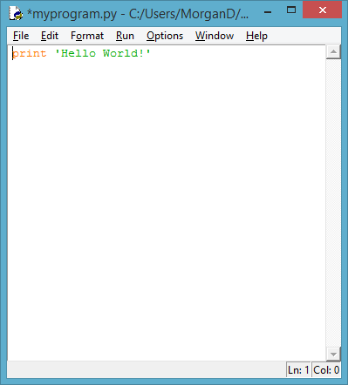
The File Editor
Write a program
E.g.
print ‘Hello World!’

Slide 8
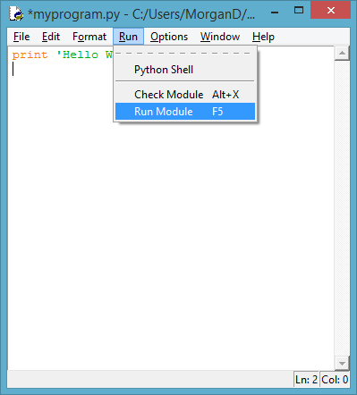
The File Editor
‘Run Module’

Slide 9
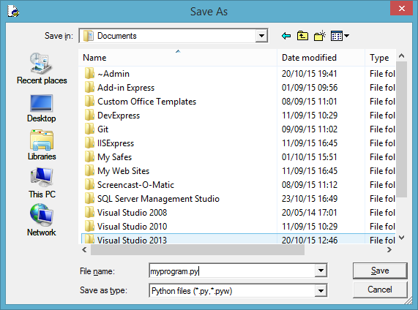
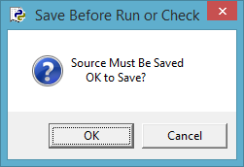
The File Editor
Save your program

Slide 10
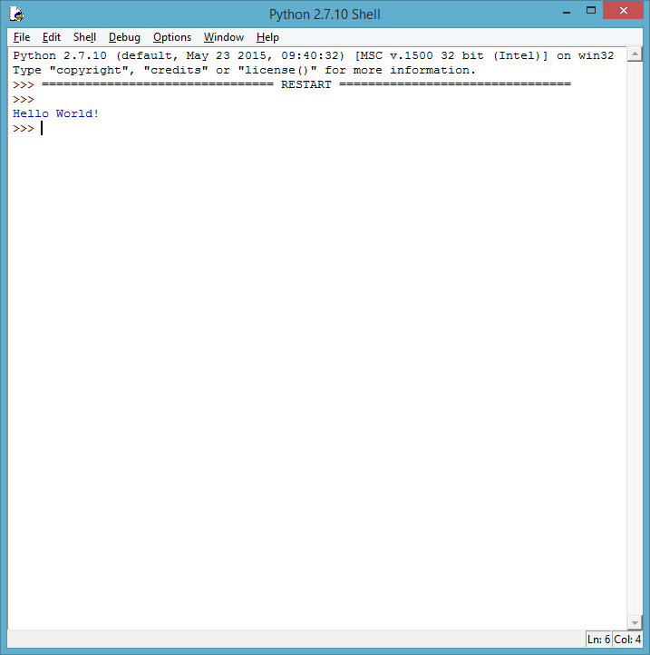
The File Editor
The program runs

Slide 11
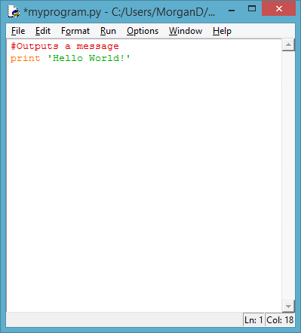
Comments
Comments enable you to add annotations to explain what your code does.
This can be useful:
to you when you come back to an old program, or
to other people who try to read your programs.

Slide 12
Comments – Examples
There is a forum thread which is famous in programming circles, asking “What is the best comment in source code you have ever encountered?”
// somedev1 - 06/07/2002 Adding temporary tracking of Login screen
// somedev2 - 05/22/2007 Temporary my ass
// drunk, fix later
// I don't know why I need this, but it stops the people being upside-down
// When I wrote this, only God and I understood what I was doing
// Now, God only knows

Slide 13
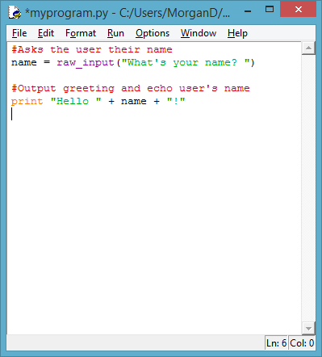
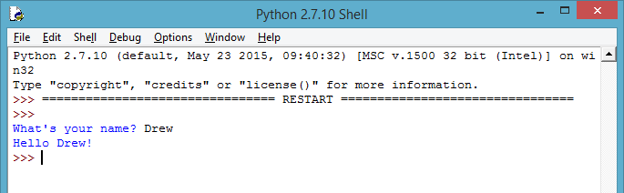
A Full Program
Here’s a greeting program.
Run the module (F5)
See below.

Slide 14
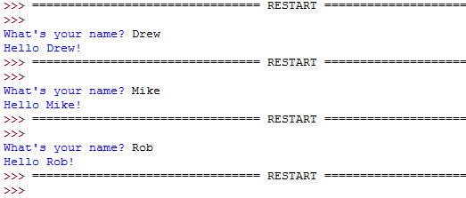
Re-Use
So far we’ve had to write the same code again if we want to re-run commands.
The editor means we don’t have to.
We can just press F5 again.

Slide 15
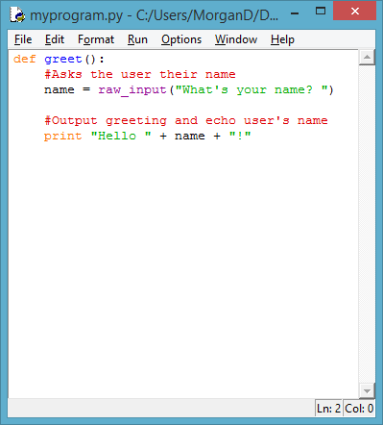
A Better Way
Computer languages let you write sections of code called ‘functions’.
It’s just like using str() or print() or raw_input() – but you get to say what happens!

Slide 16
A Better Way
def stands for ‘define’
greet is the function name
As it’s a formal language:
You need the brackets
You need the colon
All function code must line up

Slide 17
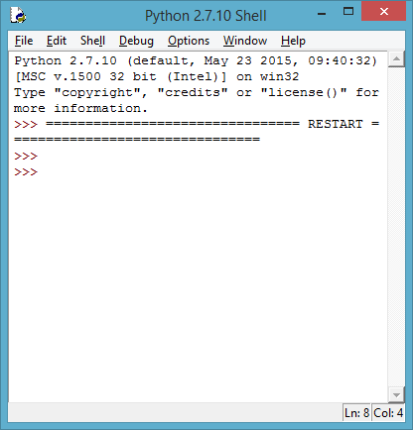
Review
This time when you press F5, nothing will happen.

Slide 18
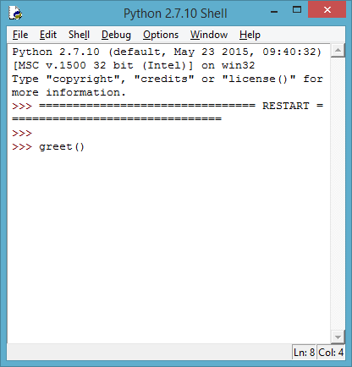
Review
This time when you press F5, nothing will happen.
That’s because Python needs to be told what to do.
Tell it to greet().

Slide 19
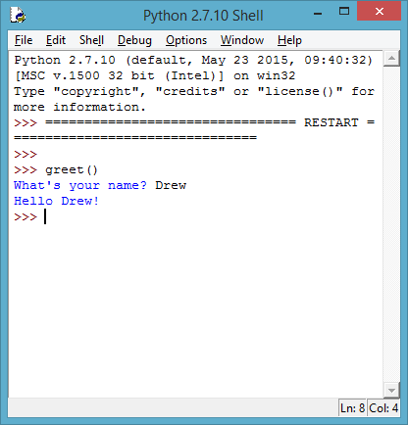
However…
This time the program has a special word you can use to tell it to do something.
So you don’t need to load and run the whole program again by going back to the editor.
Just call greet() again.

Slide 20
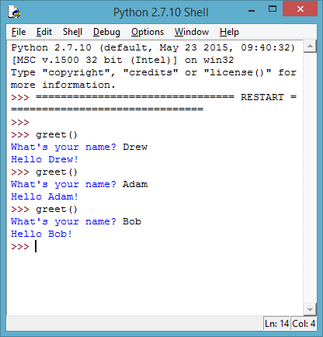
Review
Functions are snippets of code that let you wrap up a piece of code so you can ‘call’ it several times.
You don’t have to restart the shell.

Slide 21
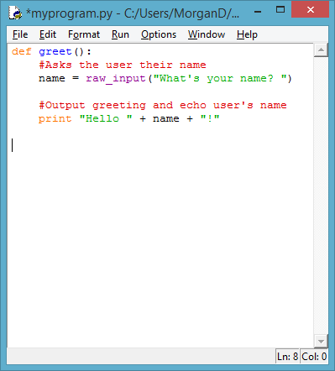
Parameters
Go back to the editor.
We don’t need to delete the greet() function – we may want to use it again.

Slide 22
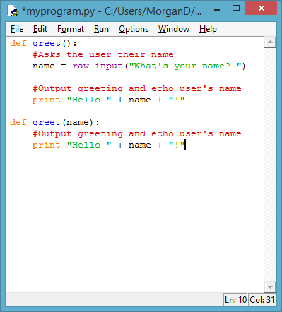
Parameters
Define a new function with a parameter called name.
This tells the function that it will be passed a piece of data that it should call ‘name’.

Slide 23
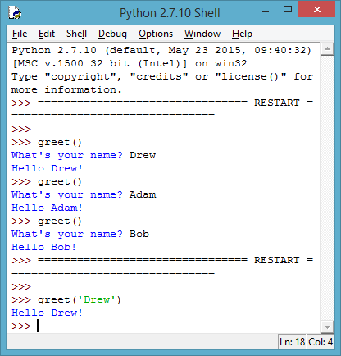
Parameters
Now when we press F5 we can call greet(…) with a string.

Slide 24
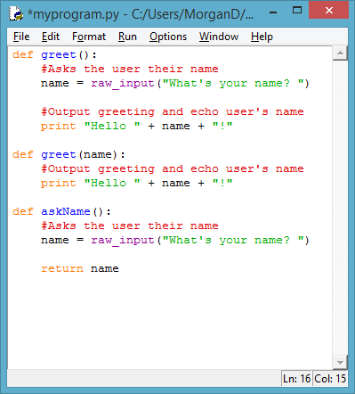
Return Values
If we wanted to, we could even make a function to ask a user’s name.
But we need to add another command – return
This sends a piece of data back to whatever called the function.

Slide 25
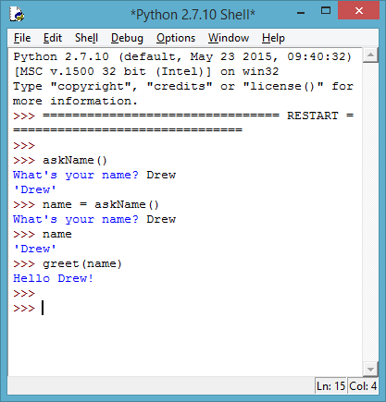
Return Values
Now when we run the program, we can combine the two.

Slide 26
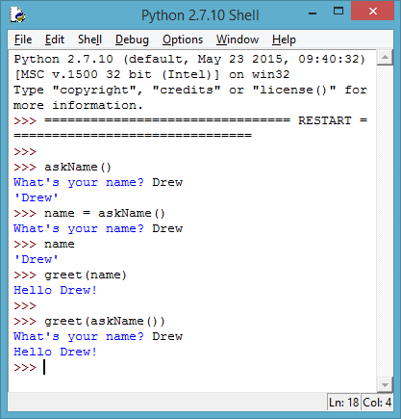
Return Values
We can even do it all in one!

Slide 27
Summary
Functions
Useful for keeping different tasks together
Many functions can be stored in one file
Can be used over and over again
Can be used to
Perform input and output tasks
Process data
Get and return data

Slide 28
Classes
Classes offer a way to group together data and functions.
In many ways they are similar to a template.
A template can be used many times, but each copy is different:
It may be in a different place on the page
You could use paint instead of a pen
You could use different colours

Slide 29
Classes
Classes offer a way to group together data and functions.
As an example, consider animals. All animals have a:
kind (insect, mollusc, amphibian, mammal, etc.)
food source classification (herbivorous, omnivorous, carnivorous)
number of limbs
name of their species
date of birth
From these we can also work out:
whether or not they are vertebrates
their age

Slide 30
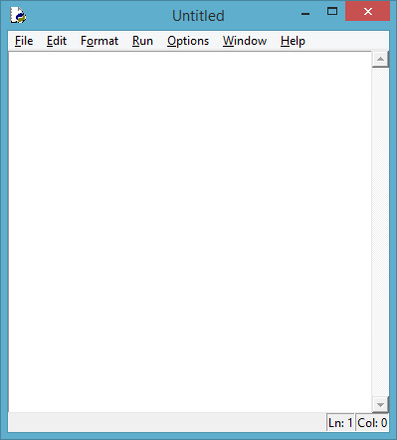
Setup
Save your last program and open a new editor window.

Slide 31
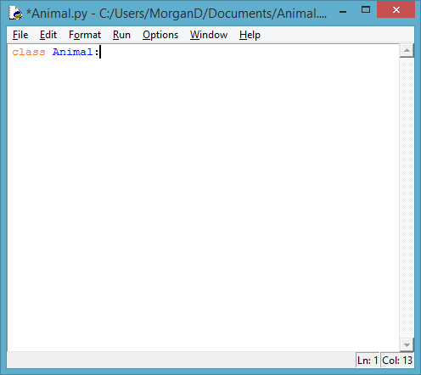
Classes
We tell Python we want a class by using that word.
We can call the class anything, as long as it doesn’t start with a number.
Remember the colon (‘:’)

Slide 32
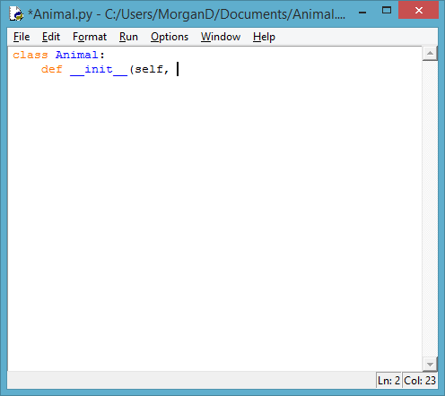
Classes
Next we give it a way to collect the data about our instance.
This is a function so we need to add def to define it.
It’s also a special function called a constructor.
As it’s a special function, we use two underscores either side.

Slide 33
Classes
The constructor initialises the class: this is where init comes from.
self is a special keyword that tells the class it is operating on itself.

Slide 34
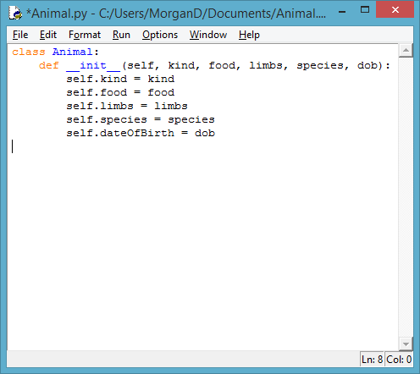
Classes
After that we start putting in the names of the parameters that will take our data.
Underneath, we tell the class to assign those values to parts of itself.
The names do not have to be the same.

Slide 35
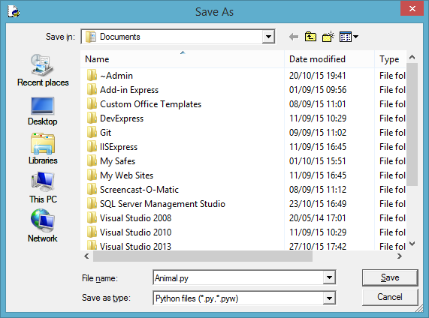
Classes
Save your class as ‘Animal.py’

Slide 36
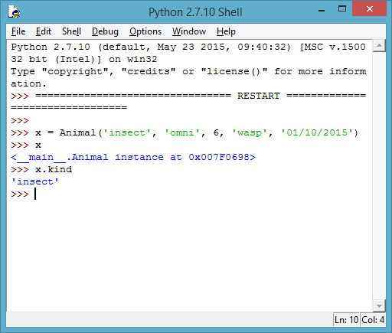
Classes
Run your module.
You can now create an instance of the class.

Slide 37
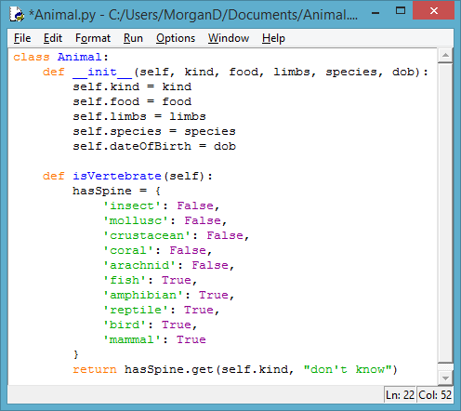
Working stuff out
If we know what kind of animal it is, we can write a function that will tell us if it’s a vertebrate.
We set up a dictionary of which types do and don’t have spines.
Then we do a ‘lookup’ and get the True/False value based on the kind of animal in the class.
If it’s not there, we “don’t know”

Slide 38
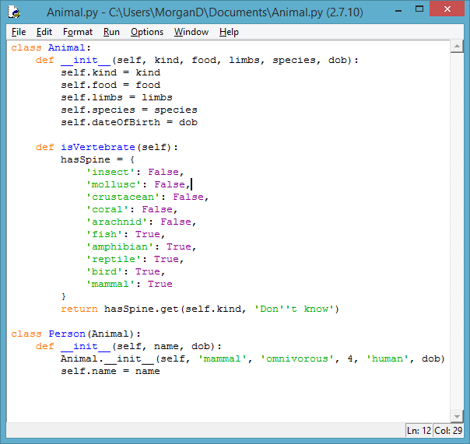
Inheritance
It would be useful to have a special class just for humans.
Let’s call it Person.
You could put this in another file, but for simplicity of putting the images in these slides I’m adding it to the end of my code.

Slide 39
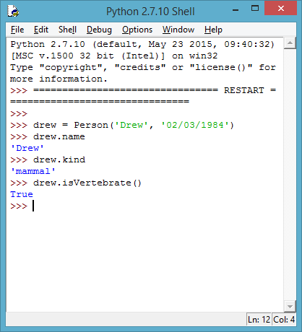
Inheritance
We can now just make a Person whenever, and only have to pass it a name and birthday. Everything else is done for us and we can still use the same data and functions as before.

Slide 40
Summary
Classes
Classes give us a way to bring together all the data and all the functions we’d want to do with a specific piece of information.
They can be combined to make complicated ideas whilst maintaining a simple way of referring back to code.

Slide 41
Challenge
Make a series of classes to represent shapes.
Shape
Circle
Rectangle
Square
Triangle
All shapes should be able to calculate their own area and perimeter
An example is usually put out on Twitter with these slides, but if not just get in touch and I’ll send you my answer.

Slide 42
Well Done!
Thank you for coming. I hope you enjoyed yourself.
If you want to try some more:
These slides will be made available online
There is a book: “Think Python – How to Think Like a Computer Scientist”
Free from http://www.greenteapress.com/thinkpython/thinkpython.pdf
You can learn for free on Code Academy
They do lots of courses, including one on Python

